Slide 1
Worship Worshiping God the Creator - 2

Slide 2
Job 40:15-24 "Look now at the behemoth, which I made along with you; He eats grass like an ox. 16 See now, his strength is in his hips, And his power is in his stomach muscles. 17 He moves his tail like a cedar; The sinews of his thighs are tightly knit. 18 His bones are like beams of bronze, His ribs like bars of iron. 19 He is the first of the ways of God; Only He who made him can bring near His sword. 20 Surely the mountains yield food for him, And all the beasts of the field play there. 21 He lies under the lotus trees, In a covert of reeds and marsh. 22 The lotus trees cover him with their shade; The willows by the brook surround him. 23 Indeed the river may rage, Yet he is not disturbed; He is confident, though the Jordan gushes into his mouth, 24 Though he takes it in his eyes, Or one pierces his nose with a snare. NKJV

Slide 3
Points to Consider
Worshiping God for the Bigness of Creation
Worshiping God for the details of Creation
The proper response

Slide 4
Bigness of Creation
We need to know we serve a God much bigger than the universe we see.
God asked Job if he has ever entered the springs of the Sea or walked in search of the deepest parts of the ocean.
God also asked Job if he understood the size of the earth.
Remember that God holds the water in the hollow of His hand and measures the earth with the span of His hand.

Slide 8
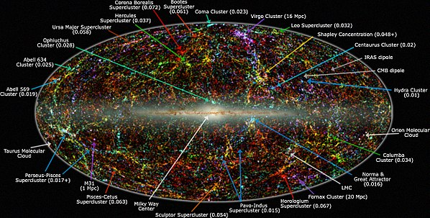

Slide 9
Details of Creation
God asked Job if he had the wisdom to make a hawk fly. Not only fly, but fly fast?
God is the only one capable of creating an eagle with the ability to see from a great distance.
God had a plan for cleaning up dead animals. We call them vultures.

Slide 10
Details of Creation
God details His careful planning of the specifics of this fierce animal.
His skin is unable to be penetrated with harpoons.
God created him with graceful proportions.
His teeth are perfect.
His scales are shup up tightly as a seal. God also designed the scales where they overlap so they are an incredible defense mechanism.

Slide 11
Proper Response
When we recognize the greatness of the God of creation one of our first responses is to worship Him.

