Slide 1
Eph 5:22-33 Wives, submit to your own husbands, as to the Lord. 23 For the husband is head of the wife, as also Christ is head of the church; and He is the Savior of the body. 24 Therefore, just as the church is subject to Christ, so let the wives be to their own husbands in everything. 25 Husbands, love your wives, just as Christ also loved the church and gave Himself for her, 26 that He might sanctify and cleanse her with the washing of water by the word, 27 that He might present her to Himself a glorious church, not having spot or wrinkle or any such thing, but that she should be holy and without blemish. 28 So husbands ought to love their own wives as their own bodies; he who loves his wife loves himself. 29 For no one ever hated his own flesh, but nourishes and cherishes it, just as the Lord does the church. 30 For we are members of His body, of His flesh and of His bones. 31 "For this reason a man shall leave his father and mother and be joined to his wife, and the two shall become one flesh." 32 This is a great mystery, but I speak concerning Christ and the church. 33 Nevertheless let each one of you in particular so love his own wife as himself, and let the wife see that she respects her husband. NKJV

Slide 2
The Letter to the Ephesians Ephesians 5:22-24 Wives Responsibility in Marriage

Slide 3
Points to Consider
Submission is a command
Submission is based on authority
Submission is extensive

Slide 4
Submission is a Command
Wives are commanded to submit to their husbands.
To submit is to place yourself under the authority of another.
Every Christian is subject to the governing authorities.
Why? Everyone is to be subject to governing authorities because they get their authority from God.

Slide 5
Submission is a Command
Those who resist this authority will bring judgment on themselves.
It is the will of God that we submit ourselves to all levels of government.
Servants are to submit to their harsh masters.
Saints in a local church must be submissive to the elders of that church.

Slide 6
Submission is a Command
A submissive wife is a good example to her unbelieving husband.
A submissive wife is chaste.
A submissive wife has a gentle and quiet spirit.
A submissive wife obeys her husband.
A submissive wife respects her husband.
Doing this is a sign of trusting God

Slide 7
Submission is a Command
Older women are to admonish young women to love their husbands and to obey their husbands.
Women are also to be discreet.
Women are to be homemakers .
The picture of the virtuous wife is one who cares for her husband and children.
The virtuous woman also does things to make money, so she can help the needy.

Slide 8
Submission is a Command
Practical Application: All married women need to be managers at home. That is a responsibility that cannot be neglected. If you are blessed to devote all of you time to the home, then work hard to make sure the house is managed well. Treat it as your fulltime job. If this is a struggle for you, seek out an older lady to advise you. Husbands and wives need to sit down and come up with a plan to divide up the household chores based on time and talents. We need to consider what our wives are doing other than managing the home and take that into consideration. If she is working fulltime, then the work at home is going to have to be divided more evenly. If she is homeschooling, then that is going to have to be considered too. Also, are your children helping around the house?

Slide 9
Submission is a Command
Am I chaste?
Do I have a gentle and quiet spirit?
Do I obey my husband?
Do I respect my husband?
Do I fulfill my role as a homemaker?

Slide 10
Submission is based on authority
The husband is the head of the wife as Christ is the head of the church.
The head of man is Christ. The head of Christ is God.
The head of woman is man.
Man was not created for the woman, but woman was created for the man.

Slide 11
Submission is based on authority
However, it is important to remember that we are dependent on one another! Mutual dependence is key to a successful marriage.
Samuel named the stone he set up “Ebenezer” which means “stone of help”.
God created woman to help man.

Slide 12
Submission is based on authority
Paul gives two reasons why a woman is not to teach or have authority over a man:
Adam was created first.
Adam was not deceived, but the woman was deceived and sinned.
Women should not only adorn themselves in modest apparel, but must also have a submissive spirit.

Slide 13
Submission is based on authority
Paul gives two reasons in this text why a woman is not permitted to speak in church, but be submissive:
The law also says.
They are commandments of the Lord (37).

Slide 14
Submission is based on authority
A wife being submissive to her husband predates the Law of Moses. It goes all the way to creation and the first sin.
However, the authority of a husband over his wife is clearly seen in the Law of Moses. (Remember Ruth)

Slide 15
Submission is based on authority
Practical Application: Women, are you willfully under the authority of your husband? Do you recognize that this is God’s plan? Are you a light in this area or are you walking in darkness? The world needs examples of how godly woman dress and live under the authority of their husbands. Are you that example? Older women, are you teaching these?

Slide 16
Submission is extensive
Wives are to be subject to their husbands as they are to Christ.
Wives are to be subject to their husbands in everything.
A wife is to respect her husband.
Sarah’s submission was so extreme that she obeyed Abraham and demonstrated her respect for him by calling him lord.

Slide 17
Challenges
Men who are unworthy of respect. Men who “lord” the authority God has given them over their wives.
Men who are unwilling to take the leadership role in the families.
Society’s expectations.
Personalities. Some personalities and/or combinations of personalities make it difficult for women to submit to their husbands.

Slide 18
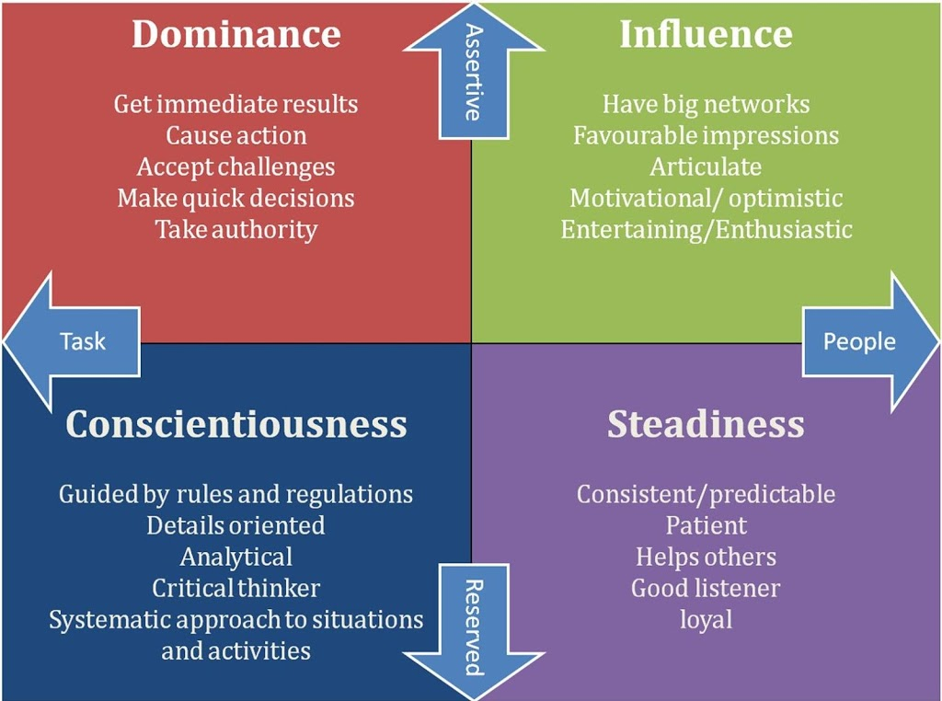

Slide 19
