Slide 1
Acts 19:11-20 11 Now God worked unusual miracles by the hands of Paul, 12 so that even handkerchiefs or aprons were brought from his body to the sick, and the diseases left them and the evil spirits went out of them. 13 Then some of the itinerant Jewish exorcists took it upon themselves to call the name of the Lord Jesus over those who had evil spirits, saying, "We exorcise you by the Jesus whom Paul preaches." 14 Also there were seven sons of Sceva, a Jewish chief priest, who did so. 15 And the evil spirit answered and said, "Jesus I know, and Paul I know; but who are you?"

Slide 2
16 Then the man in whom the evil spirit was leaped on them, overpowered them, and prevailed against them, so that they fled out of that house naked and wounded. 17 This became known both to all Jews and Greeks dwelling in Ephesus; and fear fell on them all, and the name of the Lord Jesus was magnified. 18 And many who had believed came confessing and telling their deeds. 19 Also, many of those who had practiced magic brought their books together and burned them in the sight of all. And they counted up the value of them, and it totaled fifty thousand pieces of silver. 20 So the word of the Lord grew mightily and prevailed. NKJV

Slide 3
The Letter to the Ephesians Introduction

Slide 4
Points to Consider
Basic City Information
The City’s Religious Setting
The Church of Ephesus

Slide 5
Basic City Information
A city of Ionia in Asia Minor. The city was located approximately 40 miles south of Smyrna, and near the mouth of the river Cayster.

Slide 6
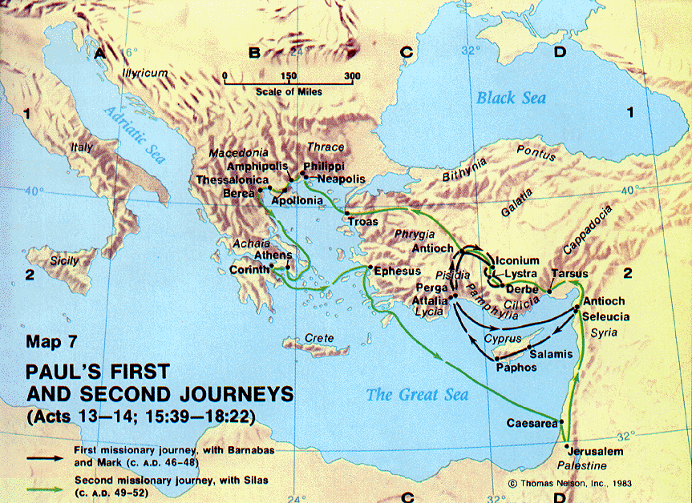

Slide 7
Religious Setting
The city’s major economic engine was the worship of the goddess Diana at the temple bearing her name.
Demetrius brought his fellow craftsmen together and convinced them that the message Paul was preaching would destroy them financially and eventually bring down the temple of Diana.

Slide 8
Religious Setting
Demetrius was concerned because Paul was not only having success in Ephesus but the rest of Asia as well.
In addition, Demetrius stated that the whole world worshipped the goddess Diana.
Paul was preaching that things made by men’s hands were not truly gods worthy of worship.

Slide 9
Religious Setting
When the multitude amassed in the theater some had no idea why they were there.
She fell down from Zeus.
In the clerk’s mind, these were facts that could not be denied. As a result, he dismissed the crowd to avoid a reprimand from the Roman government.

Slide 10
The Church of Ephesus
He left Priscilla and Aquila in Ephesus while he went to Jerusalem.
In Ephesus Aquila and Priscilla took Apollos aside and taught him “the way of God more accurately.”

Slide 11
The Church of Ephesus
John preached a message of repentance because the kingdom of heaven was coming soon.
He preached a baptism of repentance for the remission of sins.
Apollos would have been teaching people the same message.

Slide 12
The Church of Ephesus
Paul came back to Ephesus and found some disciples. He asked them if they received the Holy Spirit when they believed.
It doesn’t appear that these disciples were even aware that the Holy Spirit was real.
The connection between baptism and the Holy Spirit is so tight that Paul asked, “Into what then were you baptized?”

Slide 13
The Church of Ephesus
When these disciples heard that the Christ had already come, they were baptized in the name of the Lord Jesus.
Paul went into the Synagogue teaching the Jews about the kingdom of God.
When the Jews did not believe, Paul started sharing the message with the Gentiles as well.

Slide 14
The Church of Ephesus
While in Ephesus God worked many unusual miracles by the hands of Paul.
Even the evil spirits knew who Paul was and that they had to do what he said. God gave him that much power!
These unusual miracles became known to all the Jews and Greeks that lived in Ephesus.

Slide 15
The Church of Ephesus
Those who believed, confessed their sins and some burned their books of magic in the sight of all the people.
The word of the Lord grew mightily and prevailed in Ephesus.

Slide 16
The Church of Ephesus
Paul reminded the Ephesian elders of his selfless work in their city amid terrible persecution.
He told them that he was innocent of the blood of all men since he told both Jews and Greeks the whole counsel of God.
He emphasizes the incredible responsibility they had as overseers of God’s flock in Ephesus.

Slide 17
The Church of Ephesus
He warned them that savage wolfs would enter the flock and try and tear it apart.
He also warned that some of their own number would speak perverse things and try to “draw away the disciples after themselves.”
Paul’s departure was accompanied with hugs and tears.

