Slide 1
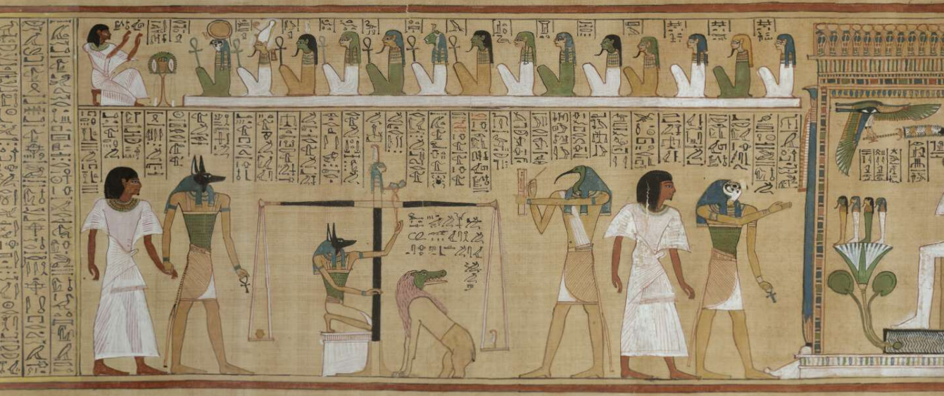
Weighed In The Balance
Pharaoh and the hardening of his heart
Egyptian Book of the Dead
Pharaoh's Heart Weighed in the Balance
by Garry K. Brantley, M.A., M.Div. and Revised by Darren Mays

Slide 2
Studying The Old Testament Builds Our Faith
To see that God follows through with His promises
To see that God has shown Himself through time to be the only true God against all others
To see the dots connected through time to bring us a Savior as we study the Scriptures in detail
To see the unity of the scriptures and archaeology match up as our limited knowledge base grows.
To see that the more one studies the Bible, the more depth of knowledge there is to learn.
Per God’s own words in Exodus 9:14 “That thou mayest know that there is none like me in all the earth!”

Slide 3
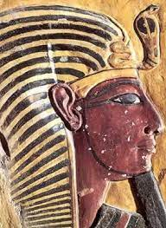
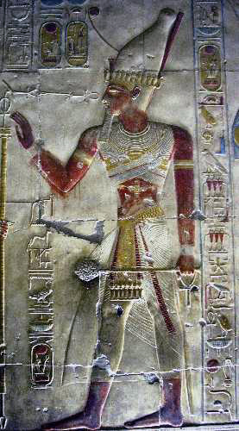
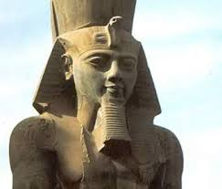
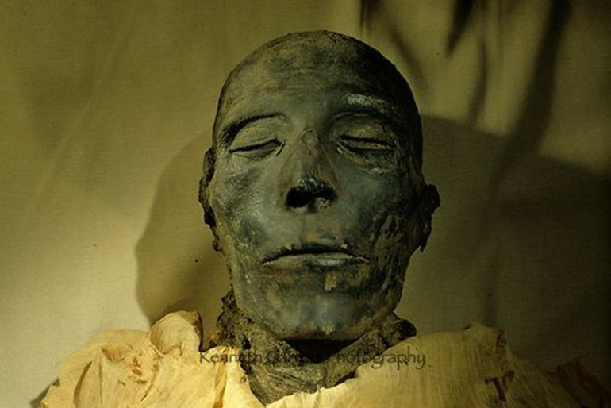
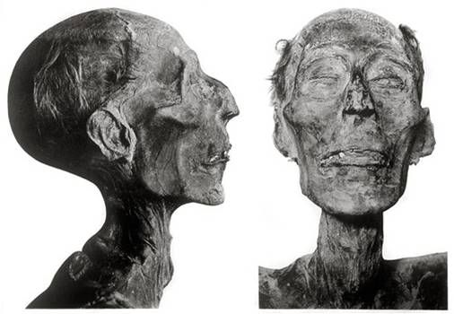
“Let My People Go” was the demand that set the stage for a conflict that literally changed history. In a devastating series of plagues, Yahweh systematically humbled the Egyptian monarch into compliance with His will. Scholars argue over the exact Pharaoh; however, it may be possible to look into the face of the same Pharaoh that faced Moses’ God – Our GOD! May this be the reason the mummies have survived so many thousands of years???
Ruler of Egypt for 67 years
Pharaoh Seti I, Reign 11-15 yrs. Pharaoh Ramses II
Ex 5:2 And Pharaoh said, Who is the LORD, that I should obey his voice to let Israel go? I know not the LORD, neither will I let Israel go. KJV

Slide 4
The theological impact of these plagues has been clarified dramatically by Egyptian mythology, which demonstrates that these phenomena were not mere random, punitive acts recklessly performed by an angry God. To the contrary, they were decisive scourges carefully calculated to expose the ineffectiveness of Egypt’s so-called gods, whom the Egyptians believed were personified in nature (Exodus 12:12). In fact, scholars have detected a direct relationship between each plague and an Egyptian god, or some aspect of ancient Egypt’s religion (see White, 1975; Davis, 1971).
Pharaoh's Heart Weighed in the Balance
by Garry K. Brantley, M.A., M.Div. and Revised by Darren Mays

Slide 5
The 10 Plagues – Jehovah Vs. gods of Egypt
 | Plague | gods of Egypt | Interesting Notes
1 | Water To Blood Exodus 7:14-25 | Khnum – Guardian of river’s source Hapi – Spirit of the Nile Osiris – Nile was his bloodstream | Duplicated by the Egyptians Occurs in Goshen where Israelites lived Dead fish – putrid smell!
2 | Frogs Exodus 8:1-15 | Hapi Frog goddess to Egypt Heqt Both related to fertility | Duplicated by the Egyptians Occurs in Goshen where the Israelites lived God let the frogs die out but they heaped them up to dispose – smell!
3 | Lice Exodus 8:16-19 | Seb – The earth god of Egypt Egyptian priests could not enter their own temples as they were considered unclean. | Not duplicated by the Egyptians Occurs in Goshen where the Israelites lived Attributed to the “finger of God” per Egyptian magicians
4 | Flies Exodus 8:20-32 | Uatchit – The fly god of Egypt | God now makes a separation between the Egyptians and the Israelites. No more plagues will come upon the Israelites. Ex.8:22. Once God removed them, there remained not one! Ex.8:31
5 | Disease on Cattle Exodus 9:1-7 | Ptah, Mnevis, Hathor, Amon (Egyptian gods associated with bulls and cows) | Affects property, food, transportation, work and farming animals Death of livestock (horses, donkeys, camels, oxen, sheep)
6 | Boils Exodus 9:8-12 | Sekhmet – Egyptian goddess of Epidemics Serapis – Egyptian god of healing Imhotep – also Egyptian god of healing | Affects physical bodies Pharaoh’s magicians cannot even appear in court. Also affected Egyptian’s beasts
7 | Hail Exodus 9:13-35 | Nut – Egyptian sky goddess Isis & Seth – Egyptian agriculture deities Shu – Egyptian god of the atmosphere | Historical uniqueness for such a storm! – not seen since the foundation of Egypt until that time! Warned to save/shelter cattle –Left cattle and servants in field to die! Wouldn’t regard God’s words after 6 previous plagues! Crops, trees and servants devastated. Pharaoh confesses his sin but later changes his mind – pride!
8 | Locusts Exodus 10:1-20 | Serapia – Egyptian deity protector from Locusts | Locusts ate the residue and trees that escaped the hail storm. Pharaoh offers a compromise that is rejected Pharaoh again confesses his sin
9 | Darkness Exodus 10:21-29 | Re, Amon-re, Aten, Atum, Horus – Egyptian sun gods Thoth – Egyptian Moon god | Dark in Egypt at mid-day – Lasted 3 days – could feel the darkness! Light was still provided for the Israelites in Goshen. Ex.10:23
10 | Death of Firstborn Exodus 12:29-36 | Osiris – Great Egyptian god of the dead & the resurrection into eternal life. This plague was a judgement on all of Egypt’s gods including Pharaoh himself Ex.12:12. In Ex.1, Pharaoh had killed the sons of Israel and would lose his first born as well. Now the Lord kills the firstborn sons of the Egyptians (Ex.12:29) as well as their cattle. Great cry in land - not a house where there was not one dead of Egyptians! Ex.12:30. Pharaoh let them go but lost his army in the Red Sea pursuing after them. Ex.14:4-31. Obedient Israelites were not harmed with the blood over their doorposts. Ex. 11:7 (Anubis –god of death in form of a dog)

Slide 6
Two terms are used for “Hardened”:
Heavy
Obstinate/Fortified/Fastened
 | Kabad | Kabed | Chazaq
Ex.7:13 |  |  | 2388 | And he hardened Pharaoh's heart,(obstinate)
Ex.7:14 | 3513 | 3515 |  | Pharaoh's heart is hardened (made heavy)
Ex.7:22 |  |  | 2388 | Pharaoh's heart is hardened, (obstinate)
Ex.8:15 | 3513 | 3515 |  | Pharaoh hardened his heart, (made heavy)
Ex.8:19 |  |  | 2388 | Pharaoh's heart was hardened,(obstinate)
Ex.8:32 | 3513 | 3515 |  | Pharaoh hardened his heart, (made heavy)
Ex.9:7 | 3513 | 3515 |  | the heart of Pharaoh was hardened, (made heavy)
Ex.9:12 |  |  | 2388 | the Lord hardened the heart of Pharaoh, (obstinate)
Ex. 9:34 | 3513 | 3515 |  | Pharaoh hardened his heart, (made heavy)
Ex.9:35 |  |  | 2388 | the heart of Pharaoh was hardened, (obstinate)
Ex.10:1 | 3513 | 3515 |  | I have hardened his heart, (made heavy)
Ex.10:20 |  |  | 2388 | But the Lord hardened Pharaoh's heart, (obstinate)
Ex.10:27 |  |  | 2388 | But the Lord hardened Pharaoh's heart, (obstinate)
Ex.11:10 |  |  | 2388 | the Lord hardened Pharaoh's heart, (obstinate)
Ex.14:8 |  |  | 2388 | the Lord hardened the heart of Pharaoh, (obstinate)

Slide 7
No doubt Pharaoh’s stubbornness was under consideration. We frequently explain correctly that God presented circumstances for Pharaoh to choose to harden his heart – after all, Pharaoh believed himself to be a god. His arrogance against the “I am, that I am” is obvious. The term expressing this strong will or “hardening of the heart” used in this cases was Chazaq.
But two other words are used to describe the “hardening of his heart” also. These terms have far-reaching implications in light of Egyptian mythology. Interestingly, two of the three words used to describe Pharaoh’s heart (all translated harden) in the Exodus narrative are kabed and kabad, which basically mean “to be heavy or weighty” (Oswalt, 1980, 1:428).
It possibly suggests that, contrary to the Egyptian belief that Pharaoh was a divine being whose heart was the epitome of purity, and therefore light as a feather, the Egyptian monarch was a sinner unworthy of eternal life (Currid, 1993, 9[6]:51).
This would serve, as did the plagues, to demonstrate Yahweh’s supremacy over the Egyptian god-king. Such information further suggests that the author of Exodus was intimately familiar with the nuances of the Egyptian religion. And, of course, Moses fits that bill perfectly as he was raised in all the ways of the Egyptians.
Acts 7:22 And Moses was learned in all the wisdom of the Egyptians, and was mighty in words and in deeds. KJV
1 Kings 4:30 And Solomon's wisdom excelled the wisdom of all the children of the east country, and all the wisdom of Egypt. KJV
Davis, John J. (1971), Moses and the Gods of Egypt (Grand Rapids, MI: Baker).
Currid, John E. (1993), “Why Did God Harden Pharaoh’s Heart?,” Bible Review, 9[6]:46-51, December.
Oswalt, John (1980), “kabed,” Theological Wordbook of the Old Testament, ed. R.L. Harris, G.L. Archer, Jr., and B.K. Waltke (Chicago, IL: Moody), 1:426-428.
Pritchard, James (1958), The Ancient Near East: An Anthology of Texts and Pictures (Princeton, NJ: Princeton University Press).
White, W. (1975), “Plagues of Egypt,” The Zondervan Pictorial Encyclopedia of the Bible (Grand Rapids, MI: Zondervan), 4:805-807.
Pharaoh's Heart Weighed in the Balance
by Garry K. Brantley, M.A., M.Div. and Revised by Darren Mays

Slide 8
Hardening of the Heart & To be Weighed in The Balance
Two different Hebrew words and their variants are used to denote the term “Hardened” with different meanings in the Hebrew adding key information!
Chazaq describes Pharaoh’s obstinate nature of holding fast against God while the other word Kabad/Kabed and its variants describes a heavy weight. (His heart was made heavy in terms of weight).
OT:2388 chazaq (khaw-zak'); a primitive root; to fasten upon; hence, to seize, be strong (figuratively, courageous, causatively strengthen, cure, help, repair, fortify), obstinate; to bind, restrain, conquer:
OT:3513 kabad (kaw-bad'); or kabed (kaw-bade'); a primitive root; to be heavy, i.e. in a bad sense (burdensome, severe, dull) or in a good sense (numerous, rich, honorable; causatively, to make weighty (in the same two senses):
OT:3514 kobed (ko'-bed); from OT:3513; weight, multitude, vehemence: -grievousness, heavy, great number.
OT:3515 kabed (kaw-bade'); from OT:3513; heavy; figuratively in a good sense (numerous) or in a bad sense (severe, difficult): OT:3516 kabed (kaw-bade'); the same as OT:3515; the liver (as the heaviest of the viscera):

Slide 9
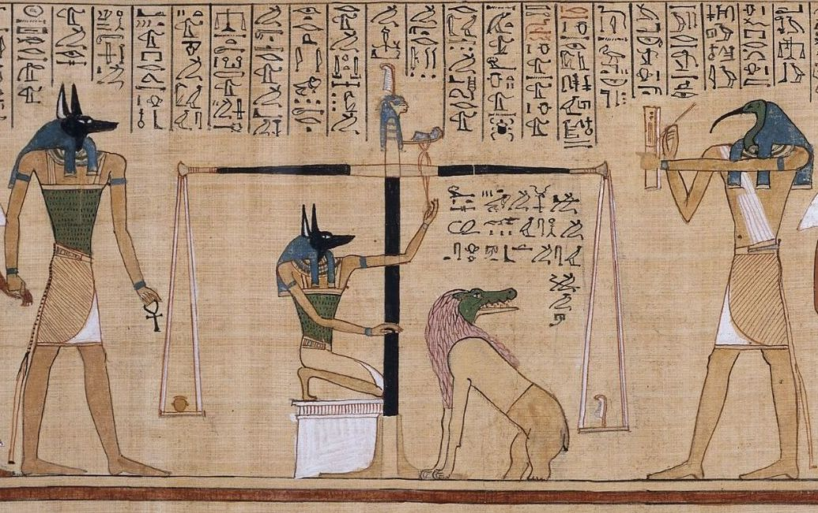
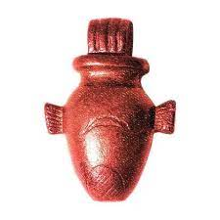
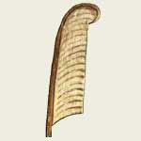
Egyptian mythology also produces a possible deeper meaning to another aspect of the Exodus narrative: The hardening of Pharaoh’s heart. The heart, according to Egyptian belief, was the seat of emotions, and represented the integrity and purity of an individual. According to the papyrus of Hu-nefer (1550-1090 B.C.), the jackal-headed god, Anubis, weighs this organ against a feather in the balance of truth. If the deceased’s heart weighed more than the feather, he or she would be judged a sinner and eaten by Amenit, the Devouress. If, however, the heart weighed no more than a feather, the deceased gained eternal life (see Pritchard, 1958, pp. 356-357; Currid, 1993).
The Egyptian Book of the Dead presents Maat as the “goddess of unalterable laws” depicted in female form with her signature feather (Budge [1960] 1990, 185).
Egyptian funerary art depicts the heart of an individual being weighed against the feather of Maat—a role later delegated to Isis—as the measure of one’s participation in a harmonious order, determining if one passes to the world beyond.
Amenit
Heart
Anubis
Feather
Pharaoh's Heart Weighed in the Balance
by Garry K. Brantley, M.A., M.Div. and Revised by Darren Mays

Slide 10
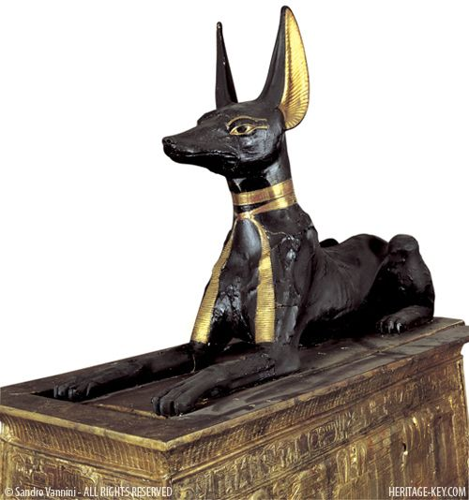
Ex 11:7 ⁷ But against any of the children of Israel shall not a dog move his tongue, against man or beast: that ye may know how that the LORD doth put a difference between the Egyptians and Israel. KJV
Anubis is the Egyptian god of mummification and the afterlife as well as the patron god of lost souls and the helpless. He is one of the oldest gods of Egypt, who most likely developed from the earlier (and much older) jackal god Wepwawet with whom he is often confused.
Again, we see that the true all-knowing God of Heaven is in control, able to protect and free His people and show his ultimate power over all the so-called gods of Egypt defeating their myths.

Slide 11
The more we study, learn and understand about our God, the more we should desire to obey His Will to receive freedom from the debt and bondage of sin. God will protect us if we obey or defeat us if we resist His Will just as in this Old Testament example. There is no time like the present to start obeying today! There is still in the 21st Century no other god than the one revealed in these accounts! The creator of the universe is all powerful! He has given us instructions to follow in this life to prepare us for the afterlife. Pharaoh always had a choice – he chose incorrectly! If you have hardened your heart, it may not be too late for you to change as it was for Pharaoh! Hear, Believe, Repent, Confess and be Baptized into the water behind me for remission of sins. If you have turned away, come back to serve this true God of Heaven. Come if you are subject to the Lord’s open invitation now as we sing!

