Slide 1
Ezek 3:16-21 16 Now it came to pass at the end of seven days that the word of the Lord came to me, saying, 17 "Son of man, I have made you a watchman for the house of Israel; therefore hear a word from My mouth, and give them warning from Me: 18 When I say to the wicked, 'You shall surely die,' and you give him no warning, nor speak to warn the wicked from his wicked way, to save his life, that same wicked man shall die in his iniquity; but his blood I will require at your hand. 19 Yet, if you warn the wicked, and he does not turn from his wickedness, nor from his wicked way, he shall die in his iniquity; but you have delivered your soul.

Slide 2
20 "Again, when a righteous man turns from his righteousness and commits iniquity, and I lay a stumbling block before him, he shall die; because you did not give him warning, he shall die in his sin, and his righteousness which he has done shall not be remembered; but his blood I will require at your hand. 21 Nevertheless if you warn the righteous man that the righteous should not sin, and he does not sin, he shall surely live because he took warning; also you will have delivered your soul."
NKJV

Slide 3
Evangelism in the Old Testament Ezekiel – Warn the People

Slide 4
Points to Consider
Don’t be afraid
Make them afraid
Give them hope

Slide 5
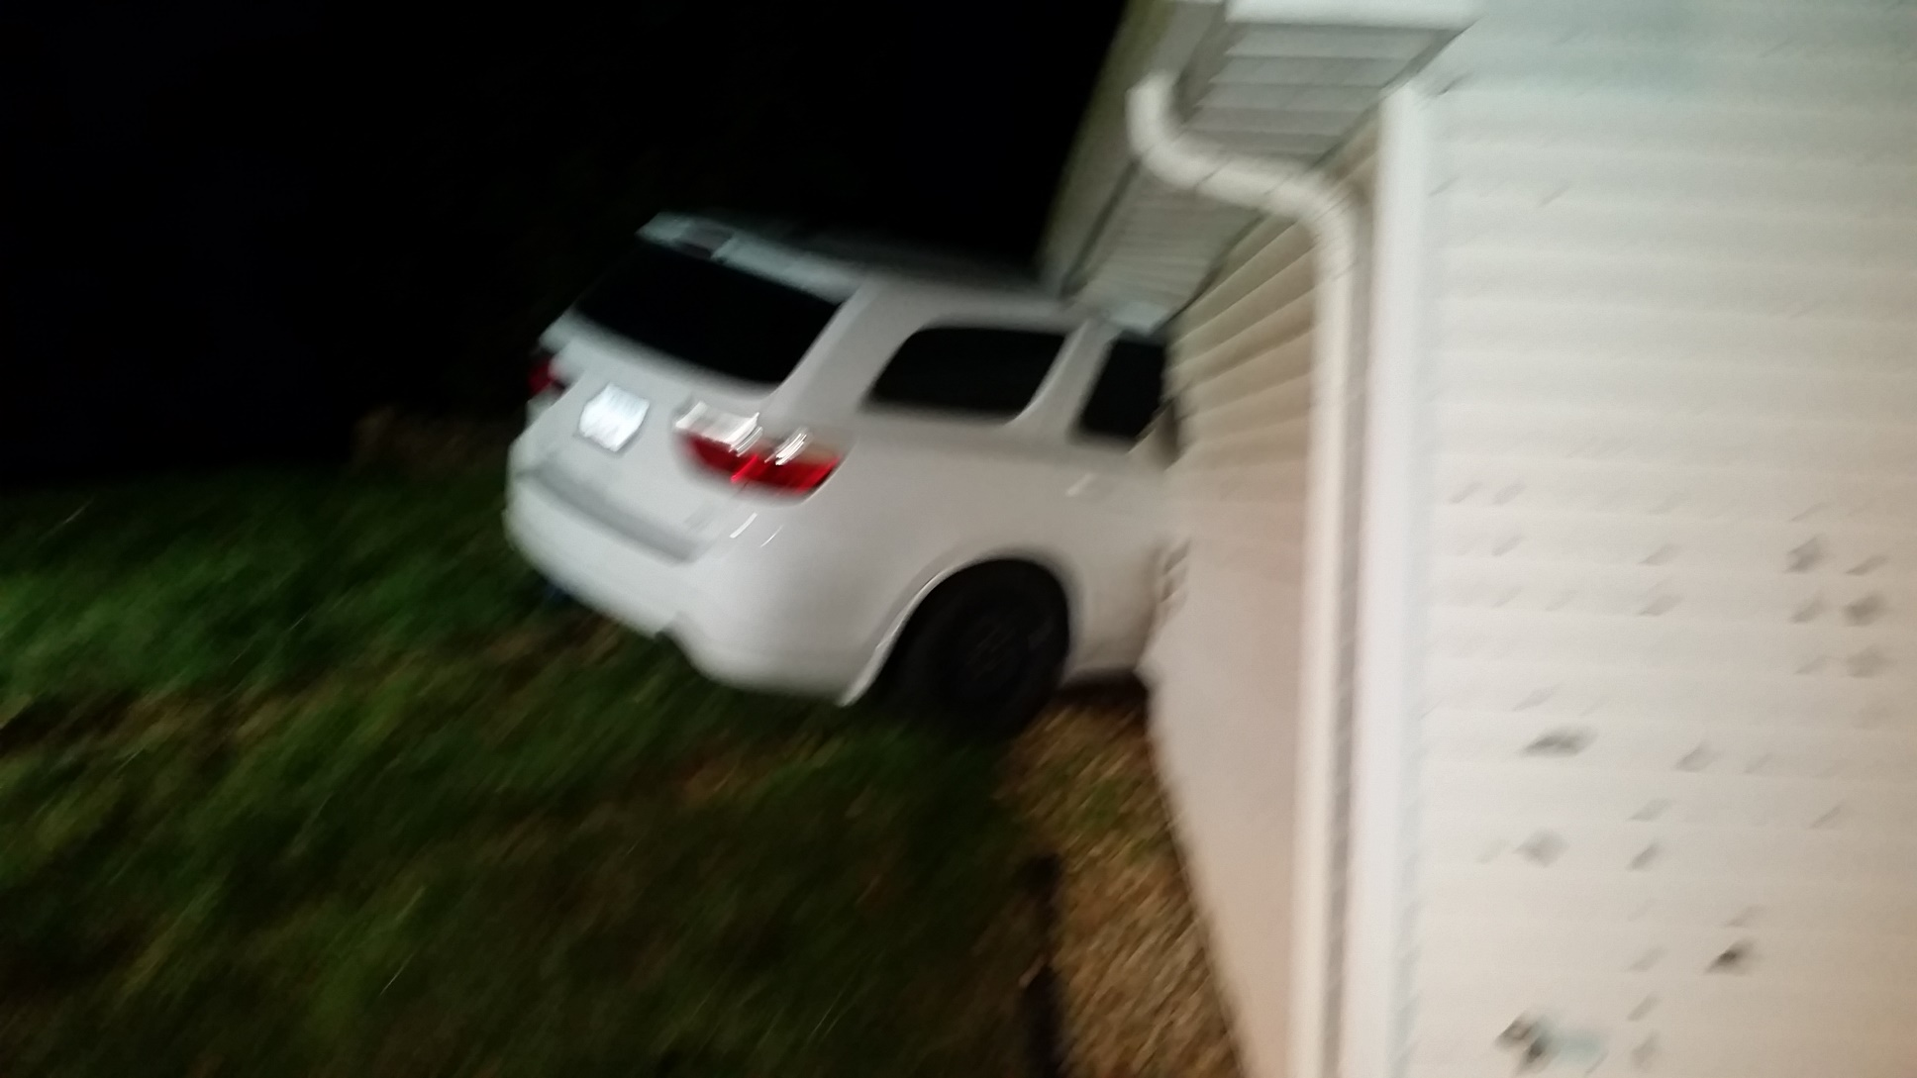

Slide 6
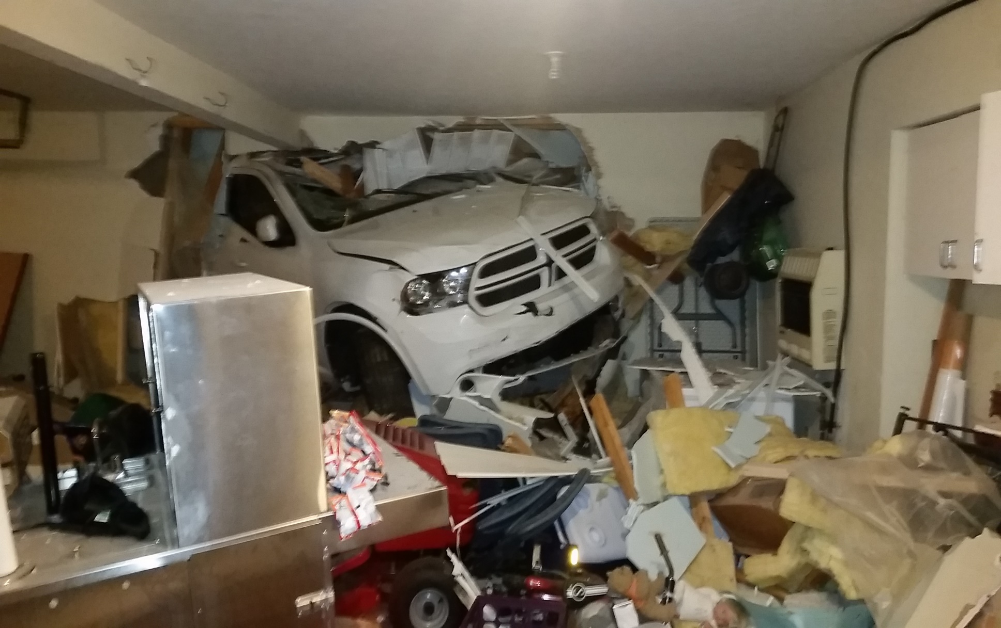

Slide 7
Don’t be afraid
Ezekiel 33:1-11
Ezekiel 2:6-7
Ezekiel 3:8-9
Matt 10:1-23

Slide 8
Make them afraid
Ezekiel 6:11-14
Acts 20:25-31
2 Cor 5:9-11
Heb 9:27
Heb 10:26-31

Slide 9
Give them hope
Ezekiel 14:-8
Ezekiel 18:30-32
Ezekiel 33:11
Luke 24:44-4
Acts 3:14-20
2 Peter 3:1-18

Slide 10
Practical Application
Remind others that they will die.
Remind others that they will be judged by God.
Remind others that God has expectations.
Remind others that those expectations can only be found in God’s word.
Remind others that repentance is an important part of God’s message.
Remind others that God wants all people to come to the knowledge of the truth and to repent of their sins.

