Slide 1
Ps 18:1-3 I will love You, O Lord, my strength. 2 The Lord is my rock and my fortress and my deliverer;My God, my strength, in whom I will trust; My shield and the horn of my salvation, my stronghold. 3 I will call upon the Lord, who is worthy to be praised; So shall I be saved from my enemies. NKJV

Slide 2
Examples of Worship A Leper and a Centurion

Slide 3
Points to Consider
Everyone is a potential worshiper
Both men knew who Jesus was
Both men asked Jesus for something

Slide 4
Everyone is a Potential Worshiper
Coming off the mountain after delivering amazing and challenging teachings a great multitude followed him and a leper worshiped Him.

Slide 5
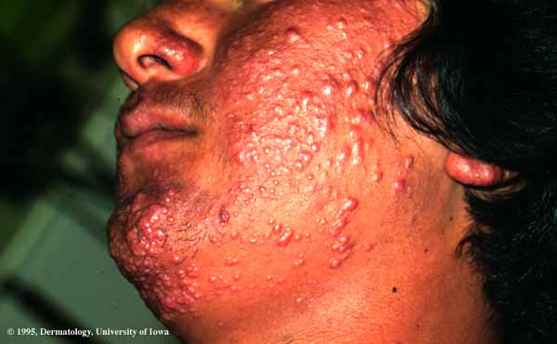
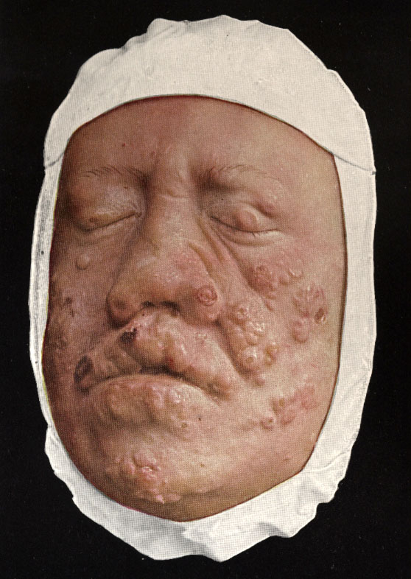
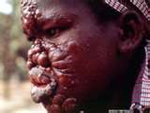

Slide 6
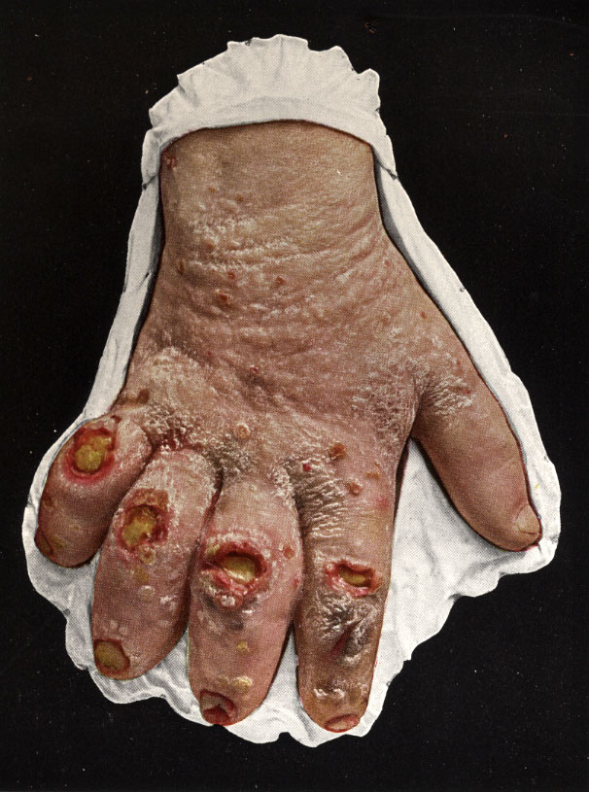
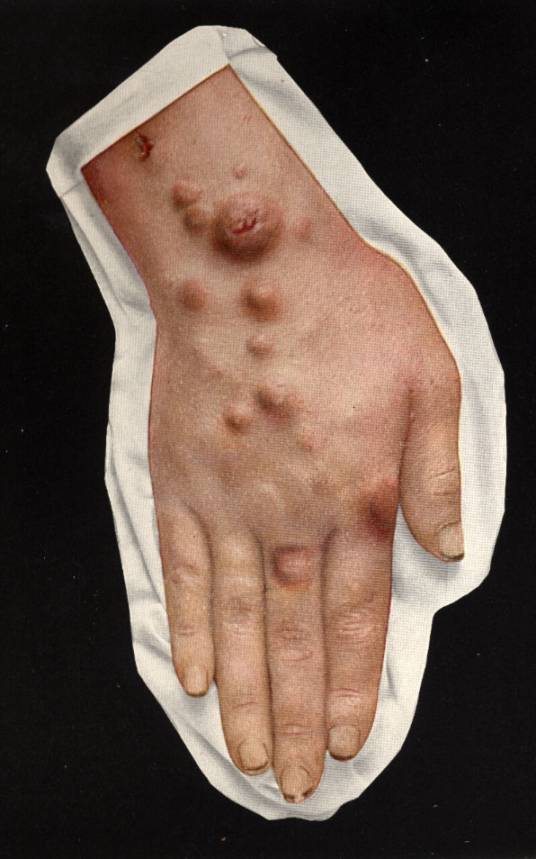

Slide 7
Everyone is a Potential Worshiper
The leper, by his own acknowledgment, was unclean.
A leper wasn’t allowed to mask their uncleanness, but rather had to announce it.
The centurion was a Roman officer with authority over 100 soldiers.
A person’s social status, Job status, or economic status does not affect one’s ability to worship God.

Slide 8
Everyone is a Potential Worshiper
A person’s nationality does not affect one’s ability to worship God.
God wants all people to worship Him.
John 4:23 – God is seeking people who will worship Him in spirit and truth.

Slide 9
Both knew who Jesus was
Both men called Jesus Lord (2,8).
Both men recognized His power.
Matt 8:2 "Lord, if You are willing, You can make me clean.“
The centurion deemed himself unworthy to be in the same house as Jesus.
He also recognized that Jesus had total authority to heal his servant.

Slide 10
Both knew who Jesus was
Not only did Jesus have the authority and the ability to heal diseases, He could also control the weather.
Jesus had the power to read thoughts, heal, and most importantly, to forgive sins.

Slide 11
Both asked for something
Both men begged Jesus for help.
Mark and Luke both say that the leper implored Jesus.
Matthew said that the centurion pleaded with him. (Matt 8:5)
Luke said that the Jews pleaded with and begged Jesus on behalf of the centurion. (Luke 7:3-4)
Both these men asked in faith.

Slide 12
Both asked for something
Faith consists of believing that God is both willing and able to help us.
The leper knew Jesus was able to cleanse him of his leprosy.
The leper had adequate faith for Jesus to grant his request.

Slide 13
Both asked for something
Jesus marveled when he saw the centurion’s faith.
As a result of the centurion’s faith, his servant was immediately healed.

