Slide 1
Gal 1:1-5 Paul, an apostle (not from men nor through man, but through Jesus Christ and God the Father who raised Him from the dead), 2 and all the brethren who are with me,
3 Grace to you and peace from God the Father and our Lord Jesus Christ, 4 who gave Himself for our sins, that He might deliver us from this present evil age, according to the will of our God and Father, 5 to whom be glory forever and ever. Amen. NKJV

Slide 2
1 Corinthians 1:1-9
God is Faithful

Slide 3
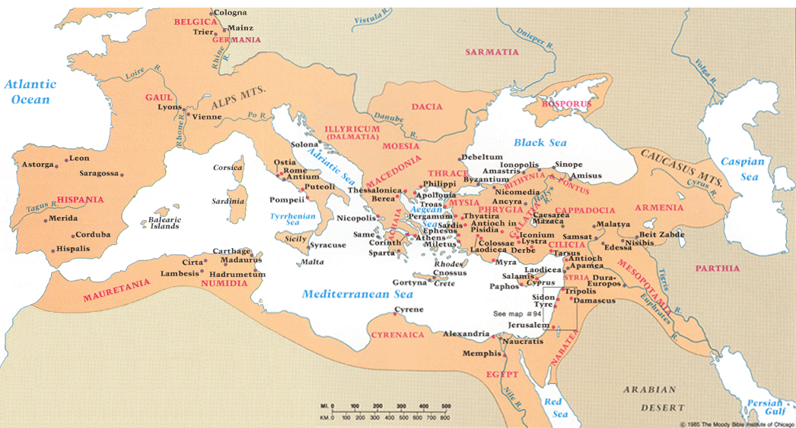

Slide 4
Corinth
The city was located on the Isthmus of Corinth and was the most important trade city in ancient Greece.
The city’s trade status brought both people and wealth.
The city’s diverse population and extravagant wealth brought extreme immorality to the relatively young city.

Slide 5
Corinth
The city was so immoral that “to Corinthianize” something was to make it excessively corrupt.
Although the city was polytheistic, Venus received a higher degree of reverence and worship.
It was law that 1,000 beautiful women serve at Venus’ temple and be available for prostitution.

Slide 6
The Establishment of the Church in Corinth
Corinth is where Paul met Aquila and Priscilla, fellow tentmakers.
We also learn that Claudius commanded that all the Jews leave Rome. Many of them settled in Corinth. As a result, the Corinthian church would struggle with the influence of Judaizing teachers.
We also learn from verse four that the church was made up of both Jews and Greeks.

Slide 7
The Establishment of the Church in Corinth
When Silas and Timothy got to Corinth, Paul started devoting himself completely to the word and focused his attention on the Jews.
His focus was on persuading them from Scripture that Jesus was the Christ.
When the Jews rejected Jesus as the Christ they started blaspheming.
Paul turns his focus from the Jews to the Gentiles. However, a prominent Jew named Crispus believed on the Lord.

Slide 8
The Establishment of the Church in Corinth
In addition to Crispus, many of the Corinthians heard, believed and were baptized.
God, knowing that things were about to get rough, promised to protect Paul as he continued to boldly spread the word in Corinth.

Slide 9
The Establishment of the Church in Corinth
God kept His promise and protected Paul from the angry mob.
However, the mob’s anger was turned against Sosthenes, the ruler of the synagogue and they beat him right in front of Gallio.

Slide 10
Introduction – 1 Cor 1:1-9
Paul starts out by reminding those in Corinth that he was an apostle of Jesus Christ.
They were the church of God at Corinth. (Acts 20:28; 1 Cor 10:32; 1 Cor 11:22; 1 Cor 15:9; 2 Cor 1:1; Gal 1:13; 1 Tim 3:5)
They were sanctified in Christ Jesus.
They were called to be saints.
They had a special relationship with everyone who calls on the name of Jesus.

Slide 11
Introduction – 1 Cor 1:1-9
Paul wants the Corinthians to receive grace and peace from God and Jesus.
Paul thanked God for the grace of God that was given to them by Christ Jesus.
Paul wanted the Corinthians to know that God is faithful.
Paul wanted everyone to know that regardless of the adversity, God delivers His people!

